Slide 1

EMBSYS 105 Programming with Embedded & Real-Time Operating Systems
Instructor: Nick Strathy, nstrathy@uw.edu
TA: Gideon Lee, gideonhlee@yahoo.com
© N. Strathy 2020
Lecture 6 2/10/2020

Slide 2
Looking ahead
Date | Lecture number | Assignment
1/6 | L1 | A1 due* before L2
1/13 | L2 | A2 due before L3
1/20 | L3 | A3 due before L4
1/27 | L4 | A4 due before L5
2/3 | L5 | A5 due before L7, Project due before L10
2/10 | L6
2/17 | Holiday – enjoy!
2/24 | L7
3/2 | L8
3/9 | L9
3/16 | L10 – Student presentations
* Assignments are due Sunday night at 11:59 PM

Slide 3
Previous Lecture (L5) Overview
Music Player Project
Assignment spec
Demo skeleton code
SPI protocol
I2C protocol
Intro to C++
Device Drivers
Intro
CHAR model
PJ driver framework
Assignment 5 – Touch driver

Slide 4
Current Lecture (L6) Overview
Connecting jumper wires to make the LCD work
Event driven MP3 player
Task priorities - Rate monotonic scheduling
Adding I2C driver to PJDF
Tracing uCOS message queue
Explore graphics library – Button class

Slide 5
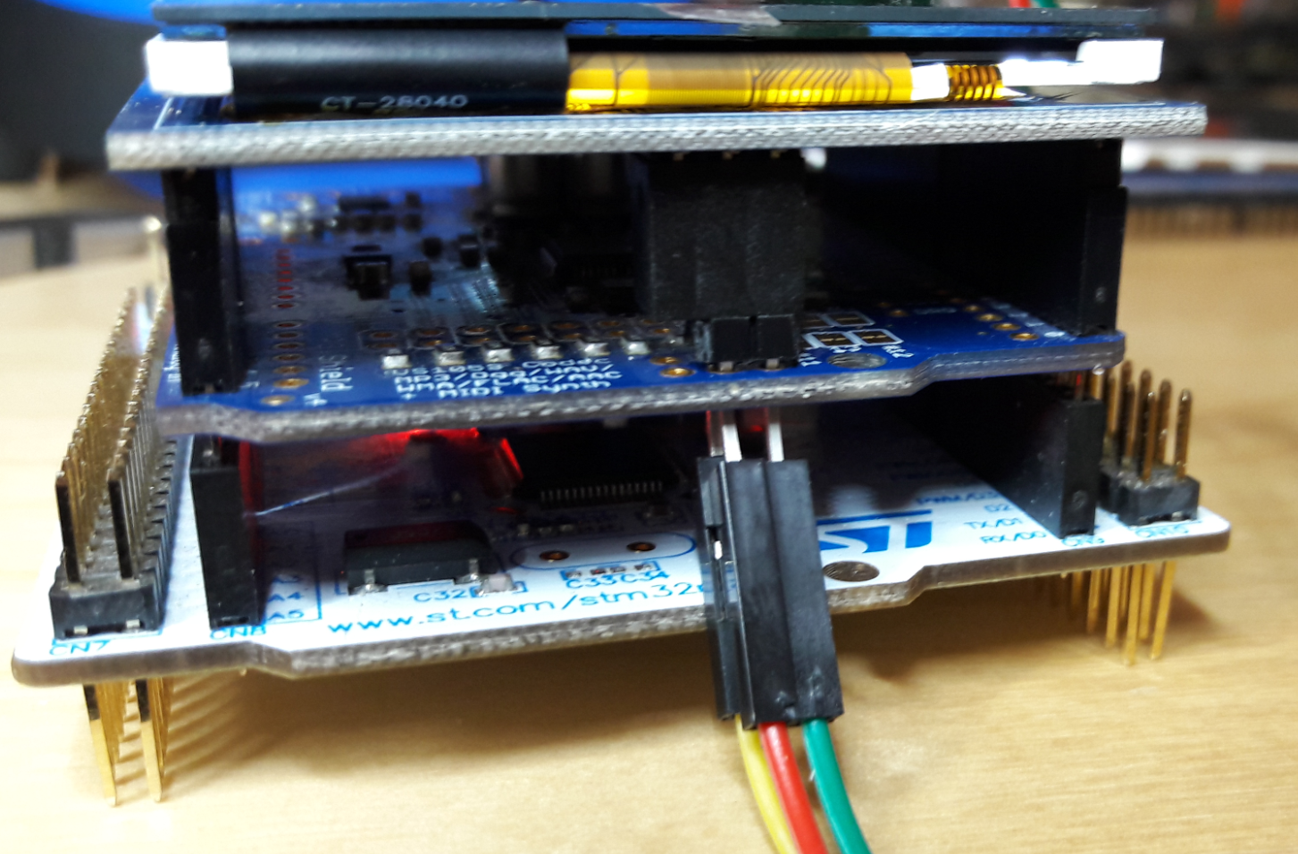
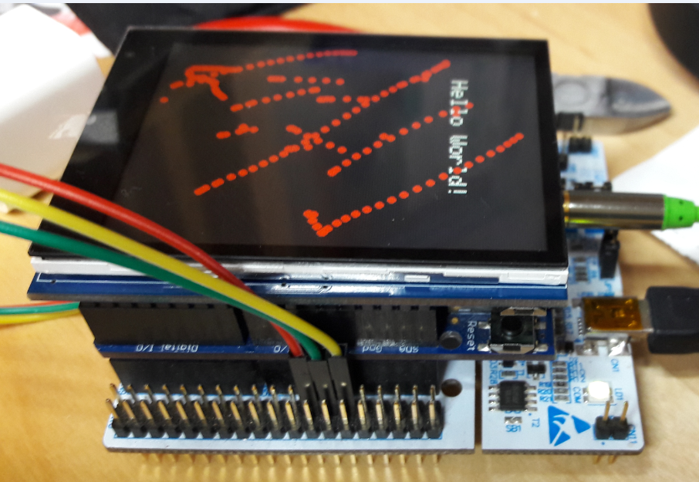
Connecting jumper wires to make the LCD work
Watch the video in the lecture to learn how to connect the jumper wires to the ICSP header
2 3 1
1 2 3

Slide 6
Event driven MP3 player
Terminals:
Input touch panel:
Event stream of x-y points from the touch panel
Button ideas: can have buttons for “play/pause”, “stop”, “fast forward”, “reverse”, volume up, volume down, etc.
Can have a “message loop” to filter each touch event to determine if it is within a button
UART: status and debugging information
LCD: display buttons, song list, current status, current song, etc.
MP3 decoder: need task to stream data to the decoder. Start/stop/pause streaming.

Slide 7
Event driven MP3 player
Review: what to implement
Required features:
Initial state: no music playing
Start: start playing an MP3 audio file from the beginning in response to a screen button touch
Stop: stop playing an MP3 audio file in response to a screen button touch
Indicate play in progress or stopped on the LCD
Add one additional functionality
UART: use for more detailed (debug) information
Optional features (suggestions):
Pause/play toggle: toggle to pause or resume playing an MP3 audio file in response to a button touch
Volume up/down in response to button touch
Move to next song in response to a button touch
Move to previous song in response to a button touch
display song list on LCD
Challenge: Read the MP3 data from the SD card instead of flash memory

Slide 8
Event driven MP3 player
Event Channel
Translate x-y touch coordinates into a known command event (enum)
Forward event to appropriate queue/mailbox
typedef enum
{
INPUTCOMMAND_NONE,
INPUTCOMMAND_FASTFORWARD,
INPUTCOMMAND_NEXTSONG,
INPUTCOMMAND_PLAY,
INPUTCOMMAND_PREVSONG,
INPUTCOMMAND_REWIND,
INPUTCOMMAND_VOLUP,
INPUTCOMMAND_VOLDOWN,
} InputCommandEnum;

Slide 9
Event driven MP3 player
Task suggestions
Touch polling task: polls the touch panel and determines if a button has been touched and forwards an event stream of button press events to the command handler task
Command handler task: receives an event stream of commands from the touch polling task such as “play”, “pause”, “next song” etc.
Streaming task: waits for a signal to begin streaming data to the MP3 decoder; checks for status updates periodically during streaming to determine whether to stop, pause, etc.
LCD task: receives events from other tasks containing information for updating the display, e.g. change status to “play”

Slide 10
Streaming task
Play/Stop flow chart – one solution
Busy wait for playerStatus to change to Playing
Setup streaming
More data and playerStatus == Playing?
Start
yes
no
Stream a chunk to
the MP3 decoder
playerStatus = Stopped;
Do stuff to stop streaming

Slide 11
Choosing task priorities
Experiment with reversing task priorities in MP3Player

Slide 12
Rate Monotonic Scheduling (RMS)
Questions:
With priority based scheduling, how can we determine the relative priority order for our tasks?
Does our CPU have enough speed to guarantee hard deadlines for our application?
Liu & Layland (1973) proved that for a set of n periodic tasks with unique periods, a feasible schedule that will always meet deadlines exists if the CPU utilization is below a specific bound (depending on the number of tasks).
A periodic task is one that does its job at a set time interval, e.g. the MP3 streaming task takes x milliseconds to send a chunk of 32 bytes to the decoder and it needs to do that every y milliseconds to maintain sound quality.
RMS applies to an ideal system and thus serves as a good starting point for a real world system.
Sources: Labrosse, and Wikipedia

Slide 13

Rate Monotonic Scheduling (RMS)
The scheduling test for CPU utilization U for n tasks is
Where C_{i} is computation time for task i, T_{i} corresponds to the execution period of task i.
In other words, C_{i} /T_{i} is the fraction of CPU time required to execute task i.
For 2 tasks, U = 2(sqrt(2) – 1) = 0.8284 i.e. we’re OK as long as our 2 tasks don’t use more than around 82% of the CPU time.

Slide 14
Rate Monotonic Scheduling (RMS)
Example for 3 tasks
RMS states that the highest rate task gets the highest priority
CPU utilization = 2/5 + 2/10 + 1/8 = 0.725
U = 3(2^{1/3} – 1) = 0.78
Since 0.725 <= 0.78 then our system should meet all hard deadlines
Task | Execution time | Period | Priority
T1 | 2 | 5 | 1
T2 | 2 | 10 | 2
T3 | 1 | 8 | 3

Slide 15
Rate Monotonic Scheduling (RMS)
Rule of thumb is to keep CPU utilization below 70% for tasks with hard deadlines.
RMS is proven for an ideal theoretical system however it is a good starting point for real world systems.

Slide 16
Adafruit_FT6206 touch driver
The Adafruit driver is designed for polling the touch panel without being interrupted.
Adafruit_FT6206.h
#define FT6206_ADDR 0x38
The 7-bit I2C slave address of the touch hardware
Assigned by NXP
Has #defines for register addresses in the touch hardware
Defines class AdaFruit_FT6206
Constructor:
Adafruit_FT6206(void);

Slide 17
Adafruit_FT6206 touch driver
Adafruit_FT6206 methods:
boolean begin(uint8_t thresh = FT6206_DEFAULT_THRESSHOLD);
Initializes the touch hardware
void writeRegister8(uint8_t reg, uint8_t val);
Writes a value to a register in the touch hardware
uint8_t readRegister8(uint8_t reg);
Reads a byte from a register in the touch hardware
void readData(uint16_t *x, uint16_t *y);
Reads a touch (x,y) point from the touch hardware
void autoCalibrate(void);
Don’t use this
boolean touched(void);
Queries the touch hardware to see if a touch occurred
TS_Point getPoint(void);
Wrapper for readData() that returns an (x,y,z) class

Slide 18
Adafruit_FT6206 touch driver
Adafruit_FT6206 usage:
Create an instance of the device in tasks.c:
Adafruit_FT6206 touchCtrl = Adafruit_FT6206();
Initialize:
touchCtrl.begin(40);
See if a touch occurred and get the touch point:
TS_Point rawPoint;
If (touchCtrl.touched()) {
rawPoint = touchCtrl.getPoint();
}

Slide 19
Adding I2C driver to PJDF
Goal:
Make class Adafruit_FT6206 hardware independent by using the PJDF Char model.
Result (ideally) will be that to port class Adafruit_FT6206 to a new microcontroller the only code we will need to change will be PJDF code and not Adafruit_FT6206 code.

Slide 20
Adding I2C driver to PJDF
Before:
tasks.c
Adafruit_FT6206.c
Touch Panel HW
After:
tasks.c
Adafruit_FT6206.c
pjdf.c
Touch Panel HW
pjdfInternalI2C.c

Slide 21
Adding I2C driver to PJDF
Steps: Begin in pjdf.h
// PJDF DEVELOPER TODO LIST FOR ADDING A NEW DRIVER:
// - define a new PJDF_DEVICE_ID_<MYDEVICE> below
// - reference it under PJDF_DEVICE_IDS below
// - add a new pjdfInternal<mydevice>.c module to implement the pjdfInternal.h interface
// - reference the Init() function of your driver in the driversInternal array in pjdf.c
// - add a new pjdfCtrl<mydevice>.h interface to define the Ioctl() functionality of your device
// - #include your pjdfCtrl<mydevice>.h in the present header file above
// - add modules as needed to the BSP folder to keep board-dependent code out of your PJDF implementation

Slide 22
Adding I2C driver to PJDF
pjdf.h
// Master list of device drivers.
// These are the identifiers used by applications to Open device drivers.
#define PJDF_DEVICE_ID_SPI1 "/dev/spi1"
#define PJDF_DEVICE_ID_MP3_VS1053 "/dev/mp3_vs1053"
#define PJDF_DEVICE_ID_LCD_ILI9341 "/dev/lcd_ili9341"
#define PJDF_DEVICE_ID_SD_ADAFRUIT "/dev/sd_adafruit"
#define PJDF_DEVICE_ID_I2C1 "/dev/i2c1"
#define PJDF_DEVICE_IDS \
PJDF_DEVICE_ID_SPI1, \
PJDF_DEVICE_ID_MP3_VS1053, \
PJDF_DEVICE_ID_LCD_ILI9341, \
PJDF_DEVICE_ID_SD_ADAFRUIT, \
PJDF_DEVICE_ID_I2C1, \

Slide 23
Adding I2C driver to PJDF
Changes to file Adafruit_FT6206.c
Modify the following functions:
Adafruit_FT6206::readRegister8()
Adafruit_FT6206::readData()
Adafruit_FT6206::writeRegister8()
Don’t call I2C_* functions from here anymore; instead call pjdf.h functions
Move the I2C_* function calls to pjdfInternalI2C.c

Slide 24
Adding I2C driver to PJDF
Adafruit_FT6206 will now become a client of pjdf
Replace the code in the following methods with calls to your driver
Adafruit_FT6206::readRegister8()
Adafruit_FT6206::readData()
Adafruit_FT6206::writeRegister8()
Adafruit_FT6206 will need a handle to your driver
You can follow a pattern similar to that of Adafruit_ILI9341 where
HANDLE hLcd is defined in the header file and initialized with setPjdfHandle()

Slide 25
Adding I2C driver to PJDF
What is being supplied to you (see PjdfI2c.zip on Canvas):
pjdf.h – already completed for you
pjdfCtrlI2C.h – already completed for you
pjdfInternalI2C.c – partially completed for you
What’s left for you to do:
Finish pjdfInternalI2C.c – just the <your code here> portions
Handle initialization of the new I2C PJDF driver
Modify Adafruit_FT6206.c and Adafruit_FT6206.h as needed to stop calling I2C_* functions and start calling PJDF functions.

Slide 26
Explore Touch specs
See handy reference links page https://canvas.uw.edu/courses/1347174/pages/embsys-105-resources
Application Note contains register spec
Data Sheet contains pin spec and electrical schematics

Slide 27
Tracing uCOS message queue
Download uCosQueue.zip from Canvas
Requires your context switch
Task one sends lower case letters
Task two sends upper case letters
Task three consumes and prints the received letters
Experiment with changing the priorities of the tasks
Consumer low pri
Consumer high pri
Set breakpoints and look at the data returned by OSQQuery()
Notice the priority of the blocked task is stored as a bit
Look at the queue in memory

Slide 28
Explore
Graphics library
Adafruit_GFX_Button button1 = Adafruit_GFX_Button(); // Declare a button
// Initialize a button for clearing the screen
button1.initButton(
&lcdCtrl,
ILI9341_TFTWIDTH-30, ILI9341_TFTHEIGHT-20, // x, y center of button
60, 40, // width, height
ILI9341_YELLOW, // outline
ILI9341_BLACK, // fill
ILI9341_YELLOW, // text color
"Clear", // label
1); // text size

Slide 29
Explore
Graphics library
// Get a touch point p
if (button1.contains(p.x, p.y)) {
// clear screen and start over
DrawLcdContents();
}

